Slide 1



Project1
View in Power BI
Last data refresh:
12.06.2025 14:11:02 UTC
Downloaded at:
12.06.2025 15:06:10 UTC

Slide 2
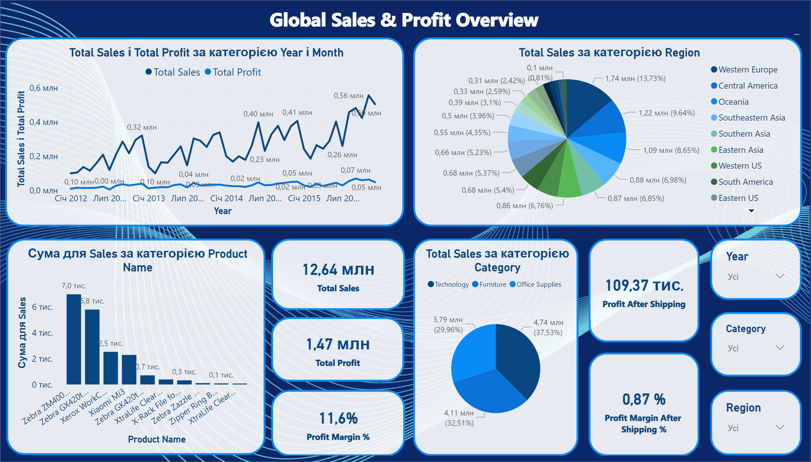
Overview
Notes:
lineChart
No alt text provided
slicer
No alt text provided
clusteredColumnChart
No alt text provided
pieChart
No alt text provided
pieChart
No alt text provided
slicer
No alt text provided
slicer
No alt text provided
card
No alt text provided
card
No alt text provided
card
No alt text provided
Global Sales & Profit Overview
No alt text provided
card
No alt text provided
card
No alt text provided

Slide 3
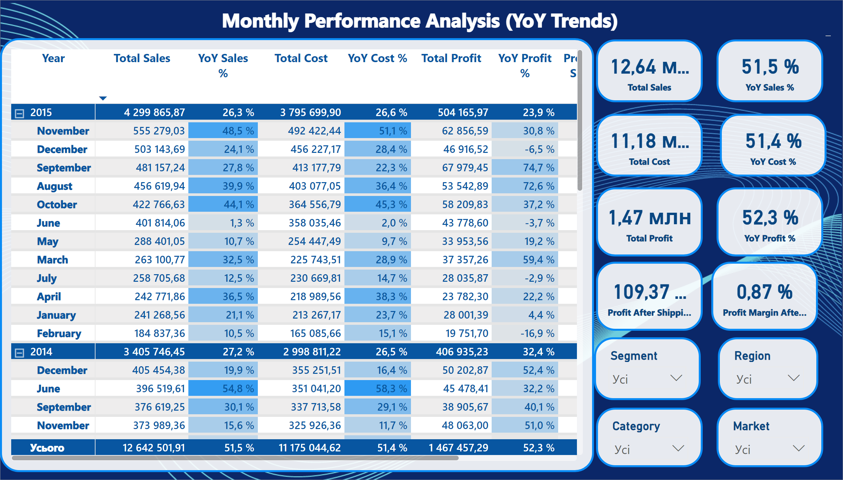
Monthly Performance Analysis
Notes:
pivotTable
No alt text provided
Monthly Performance Analysis (YoY Trends)
No alt text provided
card
No alt text provided
card
No alt text provided
card
No alt text provided
card
No alt text provided
card
No alt text provided
card
No alt text provided
slicer
No alt text provided
slicer
No alt text provided
slicer
No alt text provided
slicer
No alt text provided
card
No alt text provided
card
No alt text provided

Slide 4
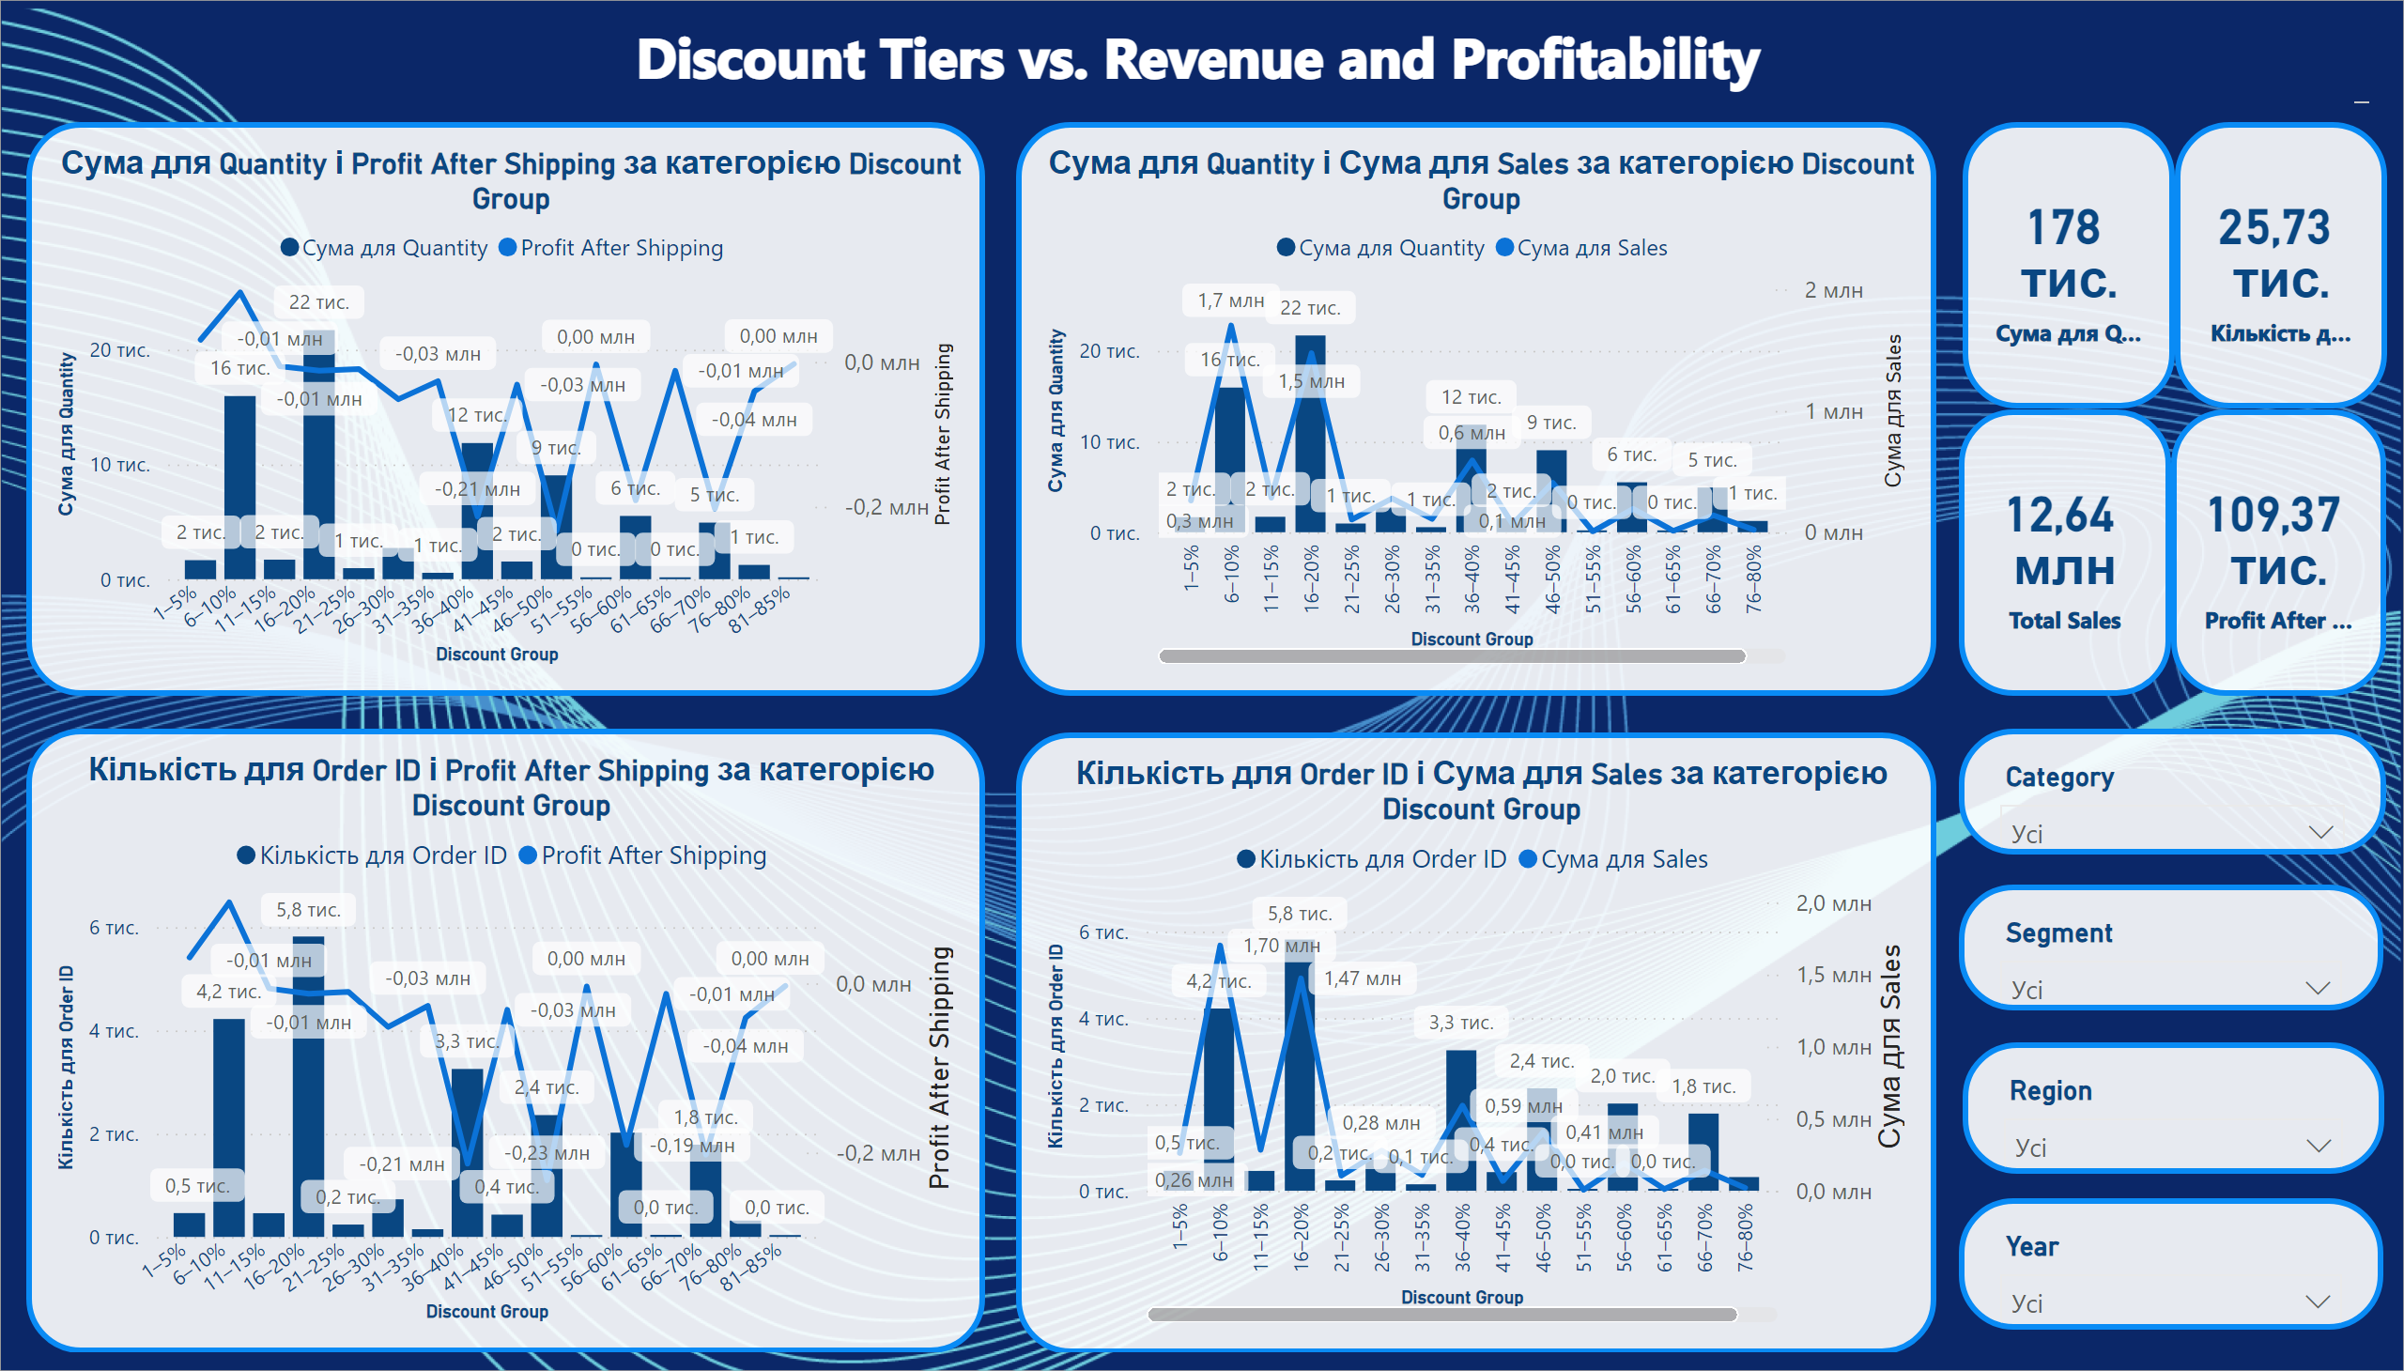
Discount Impact Analysis
Notes:
lineClusteredColumnComboChart
No alt text provided
lineClusteredColumnComboChart
No alt text provided
lineClusteredColumnComboChart
No alt text provided
lineClusteredColumnComboChart
No alt text provided
card
No alt text provided
card
No alt text provided
card
No alt text provided
card
No alt text provided
slicer
No alt text provided
slicer
No alt text provided
slicer
No alt text provided
slicer
No alt text provided
Discount Tiers vs. Revenue and Profitability
No alt text provided

Slide 5
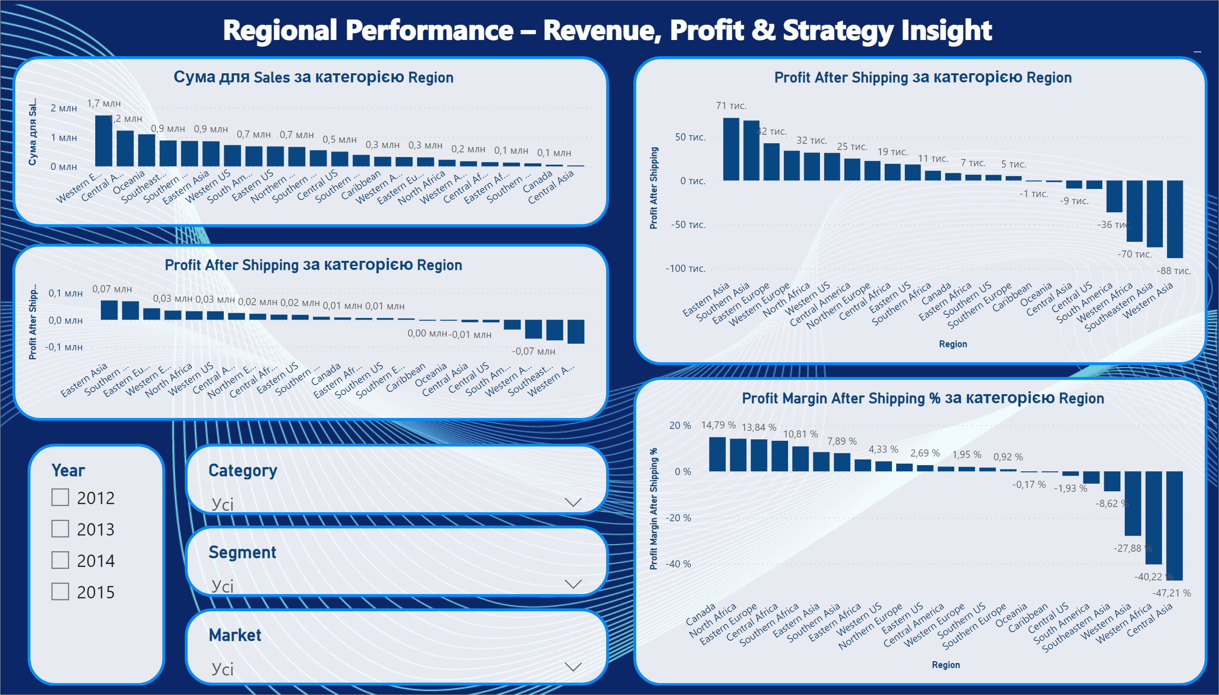
Regional Performance
Notes:
clusteredColumnChart
No alt text provided
clusteredColumnChart
No alt text provided
clusteredColumnChart
No alt text provided
slicer
No alt text provided
slicer
No alt text provided
slicer
No alt text provided
slicer
No alt text provided
clusteredColumnChart
No alt text provided
Regional Performance – Revenue, Profit & Strategy Insight
No alt text provided

Slide 6
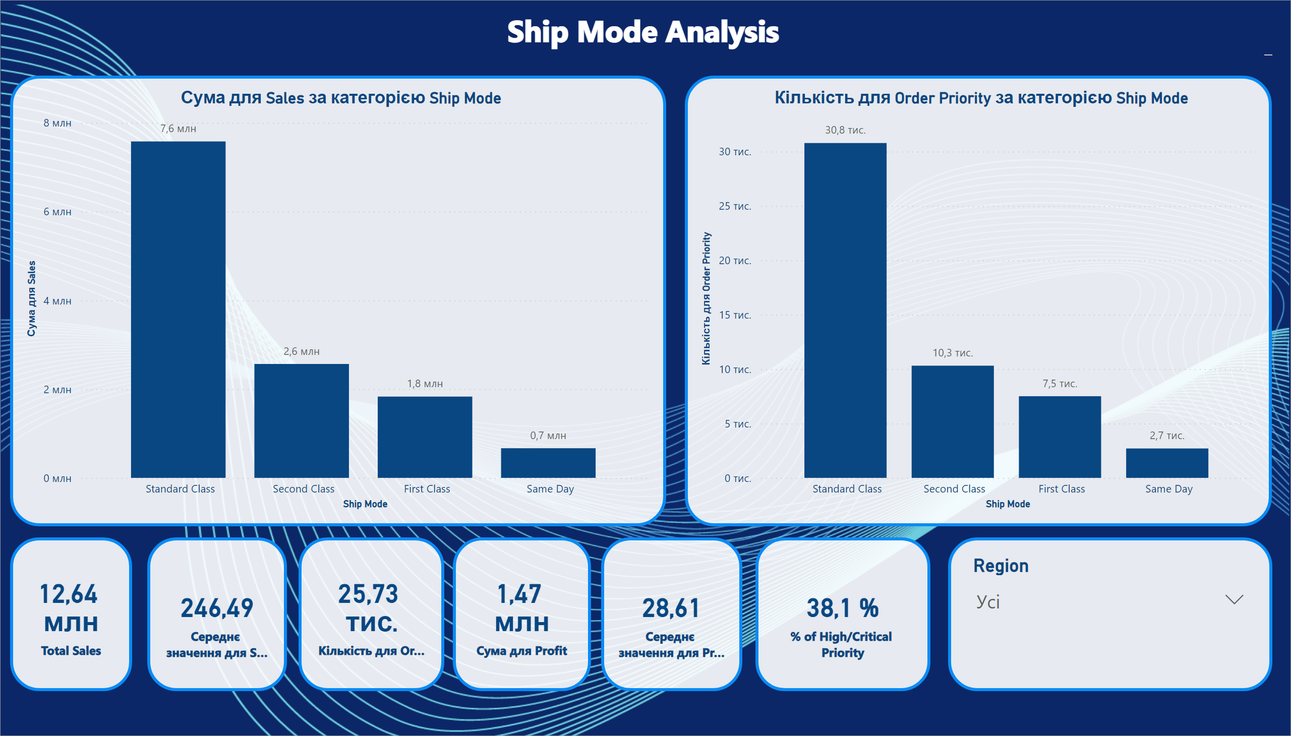
Ship Mode
Notes:
clusteredColumnChart
No alt text provided
clusteredColumnChart
No alt text provided
card
No alt text provided
card
No alt text provided
card
No alt text provided
card
No alt text provided
card
No alt text provided
card
No alt text provided
Ship Mode Analysis
No alt text provided
slicer
No alt text provided

